Slide 1


Coding Club Meeting!

Slide 2
Meeting Agenda
Welcome new members!
Club website
New Officer
Split into groups to learn Python & Java

Slide 3
Coding Club Website
https://cbsouthcoding.com/

Slide 4
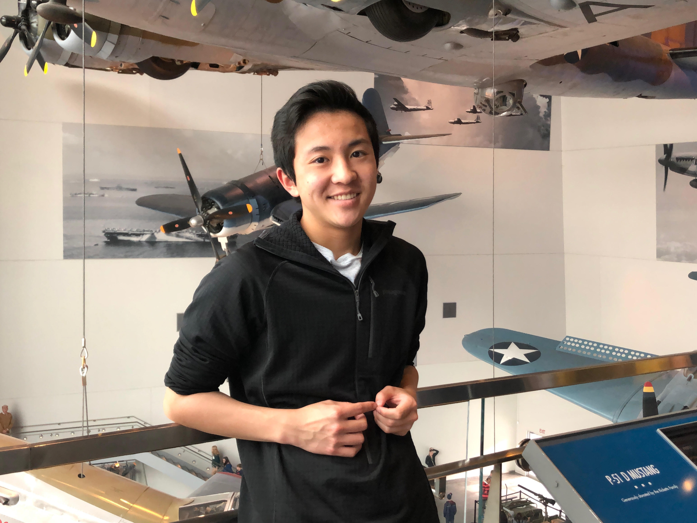
New Officer!
William Huang
Experience
Comp Sci Pri & Comp Sci A
Python & Java
Helping teach Java!

Slide 5



Python Basics – Installing Python and IDE
School laptops-https://repl.it/languages/python3
Python 3.8.5-https://www.python.org/downloads/
PyCharm IDE-https://www.jetbrains.com/pycharm/download/#section=windows

Slide 6
Python Basics
Printing stuff to console
Variables: integers, floats, strings, Booleans, lists
While loops & For loops
If statements
First function

